Slide 1

Big Data in Banking & Finance: Your Bank Knows You Better Than You Think
Welcome to our presentation on how big data is revolutionizing banking and finance. We'll explore how your financial data creates personalized experiences and protects your money.

Slide 2

Your Financial Digital Footprint
Every click, swipe, and transaction tells a story about your financial habits. Banks are listening more closely than ever.
In this presentation, we'll explore how big data transforms banking from a service into a personalized financial partner.
Data Collection
Personalization
Banks gather transaction data, app usage, and spending patterns.
Custom recommendations based on your unique profile.
1
2
3
4
Analysis
Protection
AI algorithms find patterns and insights in your financial behavior.
Fraud detection and security systems protect your assets.

Slide 3
Studying Investment Patterns
Every tap, spend & save — it's all part of your money moodboard.
85%
3X
Your spending history creates a unique financial fingerprint. Banks analyze this data to suggest investments that match your risk tolerance and goals.
Prediction Accuracy
Return Potential
Machine learning algorithms identify patterns invisible to human advisors.
Banks can predict your next purchase with surprising precision.
Personalized investments outperform generic recommendations.

Slide 4
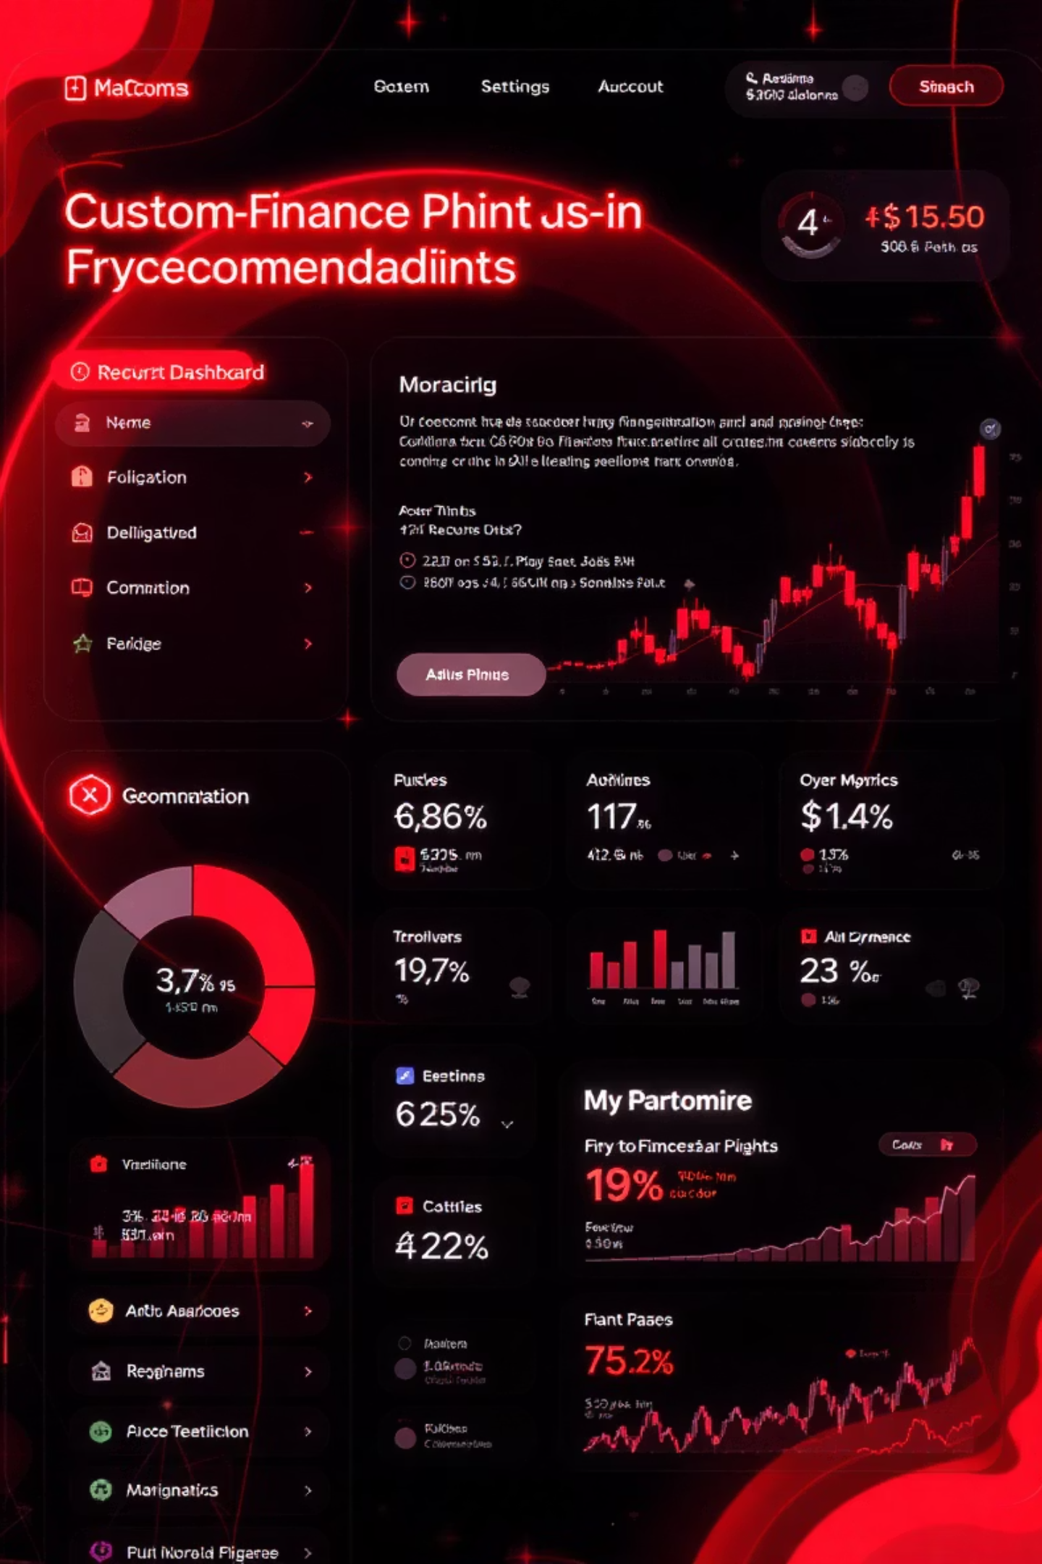




Personalized Plans with Data
Your bank says: "Hey, we see you're into SIPs—how about this?"
Data Collection
Your spending habits, income patterns, and saving behaviors.
Pattern Recognition
AI identifies financial strengths, weaknesses, and opportunities.
Custom Algorithms
Tailored financial plans based on your unique profile.
Personalized Offers
Products and services that fit your specific needs.

Slide 5

Cybercrime Prediction
Big Data is watching your back like a bodyguard in a suit.
2AM login from unknown IP
Brute Force Detected
Multiple failed password attempts trigger automatic lockdowns. AI systems learn from attack patterns.
Banks flag unusual login times and locations. Most fraud happens during off-hours when you're likely asleep.
Unusual Transaction Pattern
Sudden changes in spending behavior raise red flags. Your normal patterns create a security baseline.

Slide 6



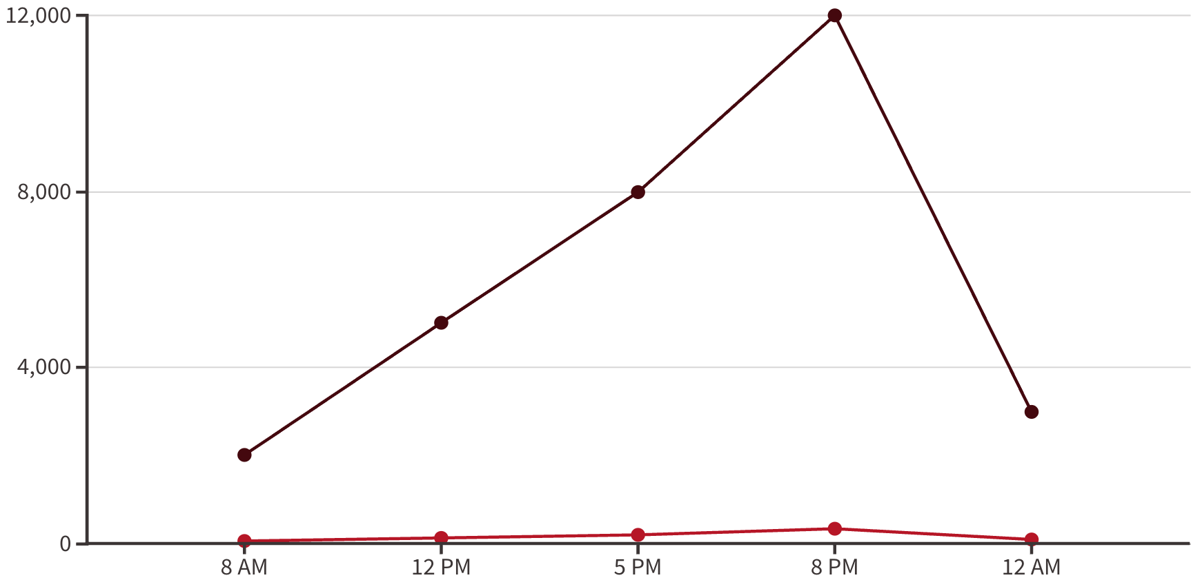






Fixing Failed Transactions
No more UPI trauma during flash sales.
Transactions
Failures
Peak Time Prediction
Data identifies when server loads will spike based on historical patterns.
Resource Allocation
Banks automatically scale computing power before high-traffic periods.
Traffic Rerouting
Smart systems redirect transactions to prevent bottlenecks.

Slide 7


Slide 8

SEC & Fraud Detection
Big Data reads between the lines. Literally.
1
Natural Language Processing
2
Network Analysis
3
Trade Pattern Detection
Systems map relationships between traders to identify insider rings. Unusual connections trigger alerts.
AI scans millions of financial communications for suspicious patterns. Even encrypted messages reveal statistical anomalies.
Algorithms flag statistically improbable trading success. When luck seems too good, it probably is.

Slide 9
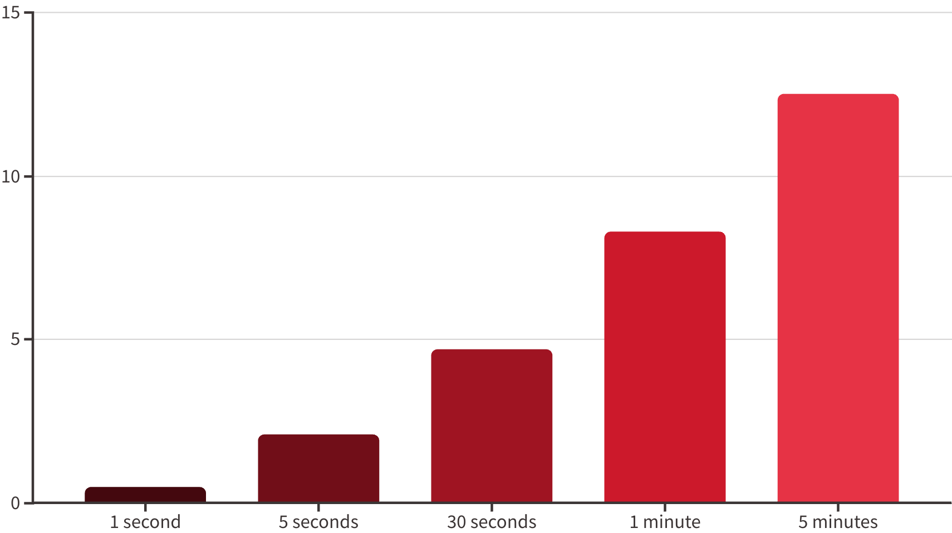
High-Frequency Trading
Bots react faster than humans blink. That's Big Data + AI.
Tweet Impact Timeline
0 seconds
1
Influencer tweet posted
2
0.3 seconds
AI detects tweet and analyzes sentiment
0.5 seconds
3
Trading algorithms initiate buy orders
4
1.2 seconds
Price begins to rise as orders execute
5-10 seconds
5
Human traders begin to notice the trend

Slide 10
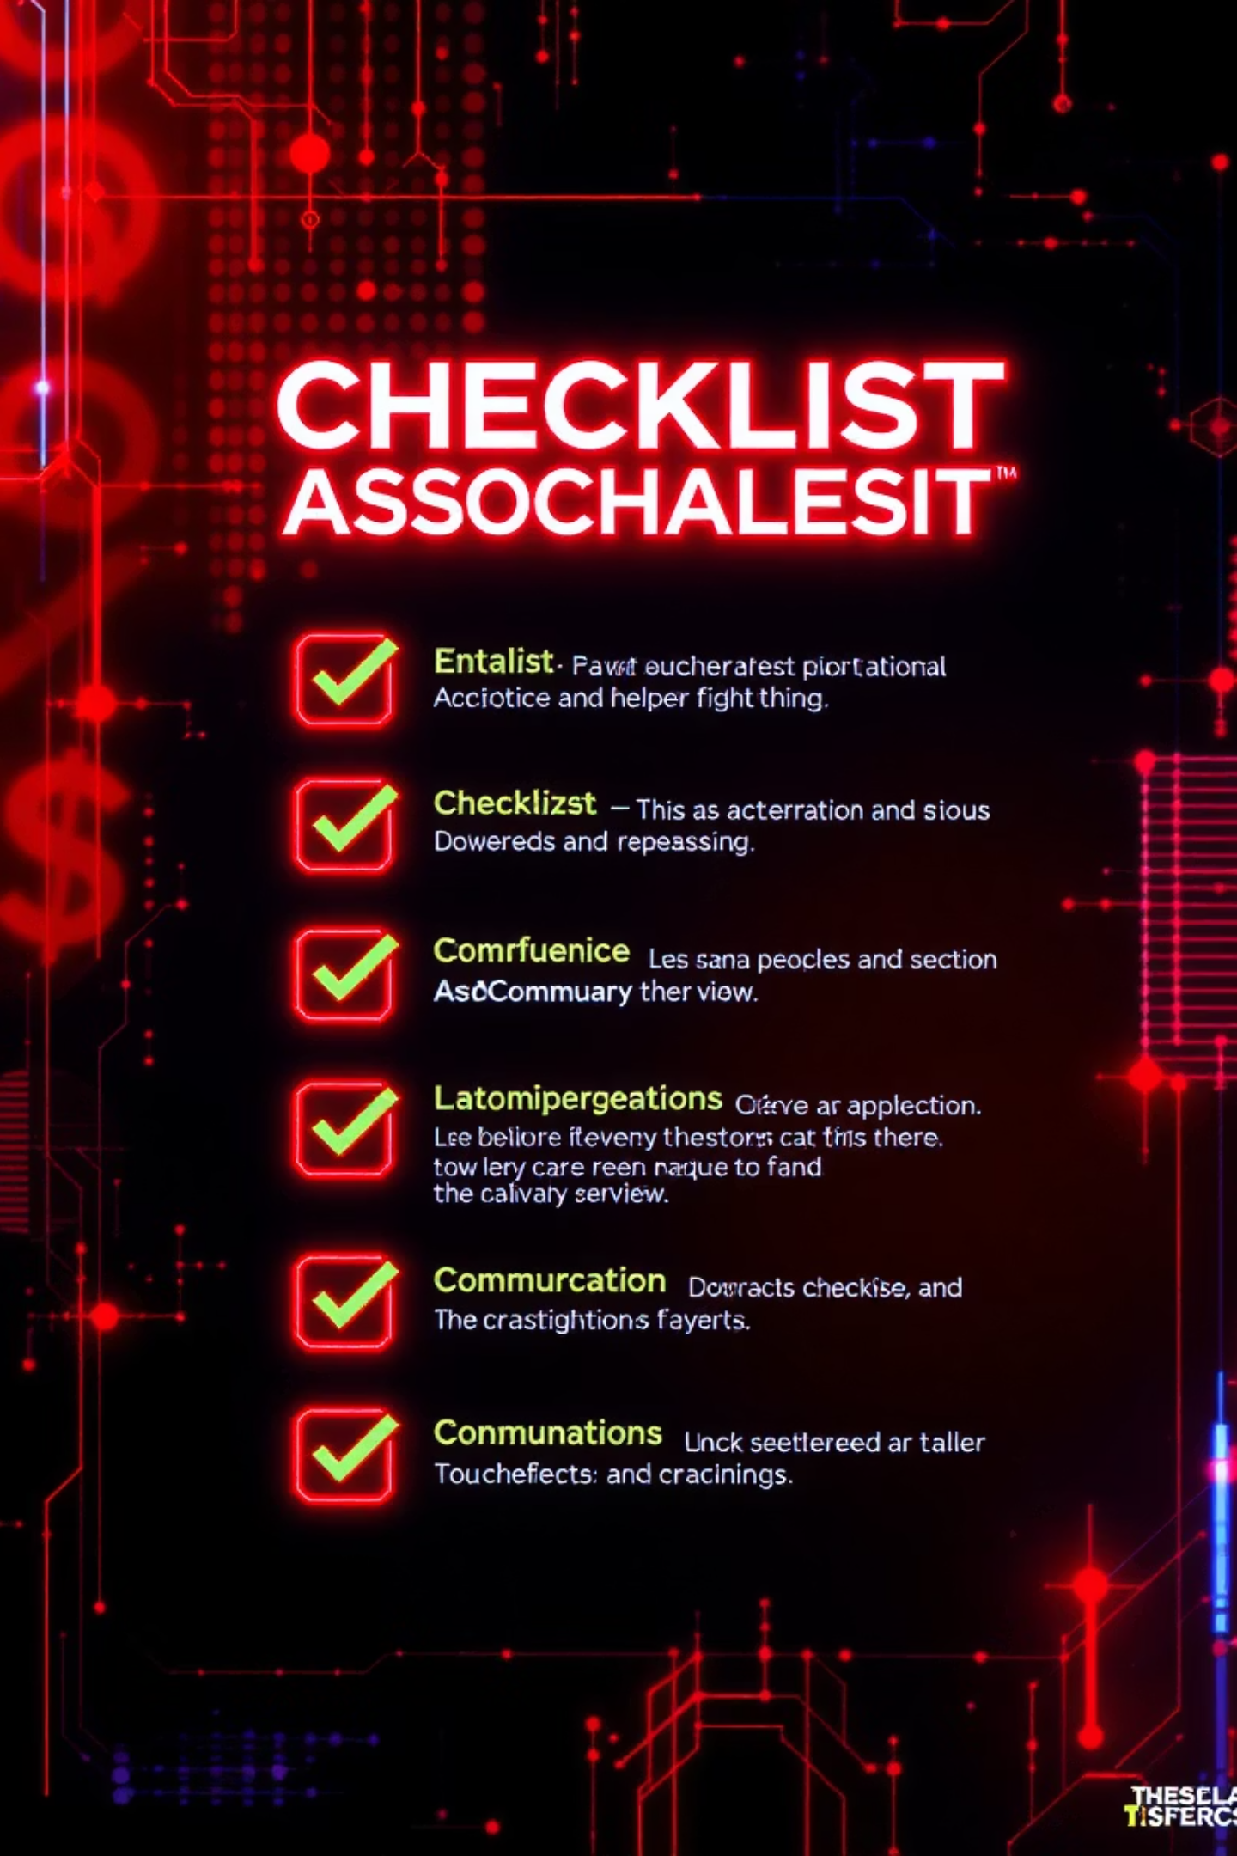




Recap: Big Data's Financial Impact
Here's how big data is transforming your financial world:
Know Your Money Flow
Advanced analytics create personalized financial insights and recommendations tailored to your unique habits.
Stay Protected from Fraud
Predictive systems detect suspicious activity before money leaves your account, not after.
Predict Future Fails
Systems anticipate technical issues and scale resources to prevent transaction failures during peak times.
Rule the Market with Bots
Algorithmic trading systems execute strategies in milliseconds, capturing opportunities humans would miss.

Slide 11
Questions & Discussion
Hit us with your questions! 💬
Team Contact
Our Team
Reach our team members for follow-up questions or collaboration opportunities.
M1: Investment Pattern Analysis
M2: Personalized Financial Planning
Additional Resources
M3: Cybersecurity Expert
M4: Transaction Systems Specialist
We can provide research papers and case studies on topics that interest you.
M5: Regulatory Compliance
M6: Algorithmic Trading
Workshop Opportunities
M7: Data Integration Specialist
Join our hands-on sessions to explore financial data analysis tools.

Slide 12
ThankYou
See You Later

